Slide 1
System Proposal for Klaus Brewing Company

Slide 2
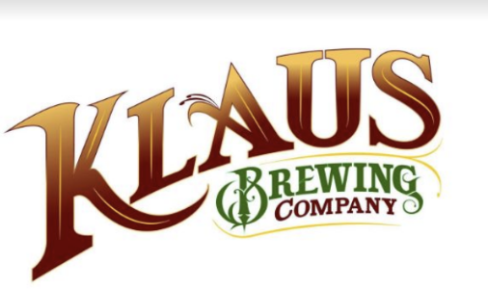
Introduction
Client : Klaus Brewing Company
Team Members: Pratik Asarpota, John-Joshua Izuegbu, Faryal Khan, Adekunle Kukoyi, Chantera Lazard, Sean Tran

Slide 3
Our approach
Our group has decided to take the SDLC approach towards this project by analyzing and designing with a phased approach
By using this approach, we will provide client with best deliverable solution possible and meet all their objectives as well.

Slide 4
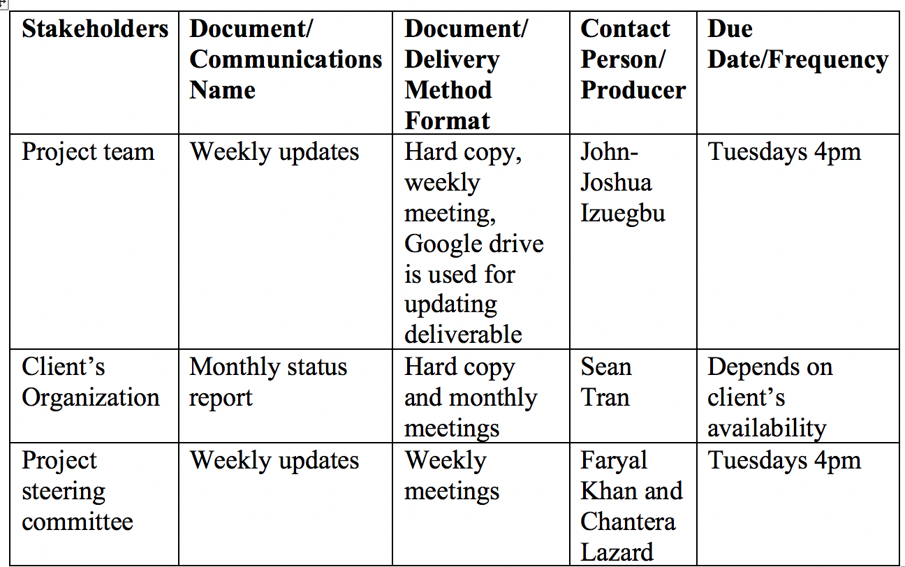
Communications management plan
Since communication is an extremely important key when it comes to succeeding in a project, our team is making sure that we communicate accordingly and are constantly keeping in check what updates or issues we need to work on as a team and as individuals.
Through the use of google drive, the entire team can keep up with all deliverables since everyone is required to submit their deliverable on the drive by specific date assigned to each individual.
If a group member has any concern about updating or modifying the communications management plan, they can talk to project manager regarding their concern and project manager can update the communications management plan.

Slide 5
Our Client - Klaus Brewery

Slide 6
Projection Selection Analysis
We all had separate strategies on how we searched for clients. Some of us did research and looked into small local businesses and contacted them. Others took a day out to visit small businesses near them. A few of us knew people with local businesses and reached out to them.
Our first potential client was a salon named MC hair salon discovered by Fayal. She was able to speak to the owner and the owner was interested in First Path Consulting helping her. The reason we chose not to work with her was Fayal was trying to follow up with the owner and she was having trouble getting in touch with her. Eventually, the owner responded and stated she was uninterested because she was not able to commit since she was too busy.
Our second potential client was a manufacturing company named Umbilicals International discovered by Chantera. She focused on the accounting department because it consisted of two individuals and her mother worked there so she was familiar with their issues.The reason we decided not to go with this client is Umbilicals international recently switch CEOs and they were unsure if the new CEO would give them clearance to share information with our Consulting Firm.
Our last potential client was a brewery named Klaus Brewing Company discovered by Sean. Sean was able to secure the brewery as our client. Sean scouted this client because his sister works at the Brewery and is able to discuss problems with him even after hours which would be beneficial to both parties.

Slide 7
Client Organization Background
Klaus Brewing Company was founded by a local group of family and friends led by passionate brewer Thomas Lemke. Focused on bringing the underserved German-style beers to a wide range of consumers, from beer aficionados to new converts alike. They chose the name Klaus because they wanted a strong traditional German name. The name's meaning is "The People’s Victory". The company feels being able to offer people the ability to experience great locally crafted beer in a welcoming environment is truly a victory for everyone.

Slide 8
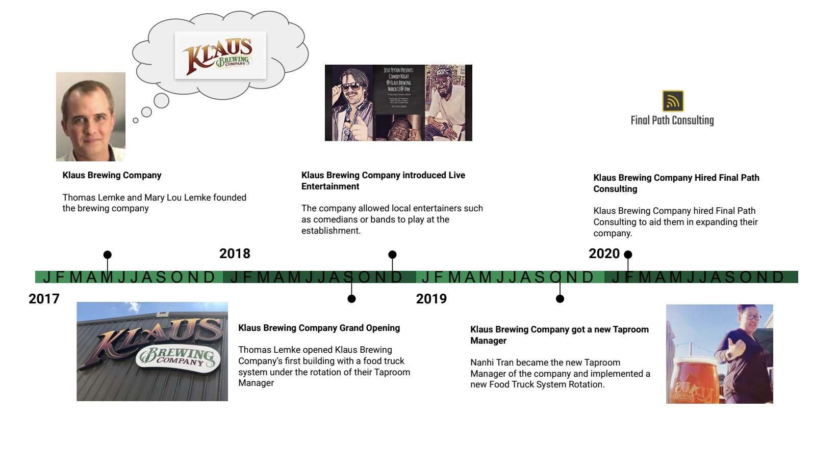
Client Organization Timeline

Slide 9
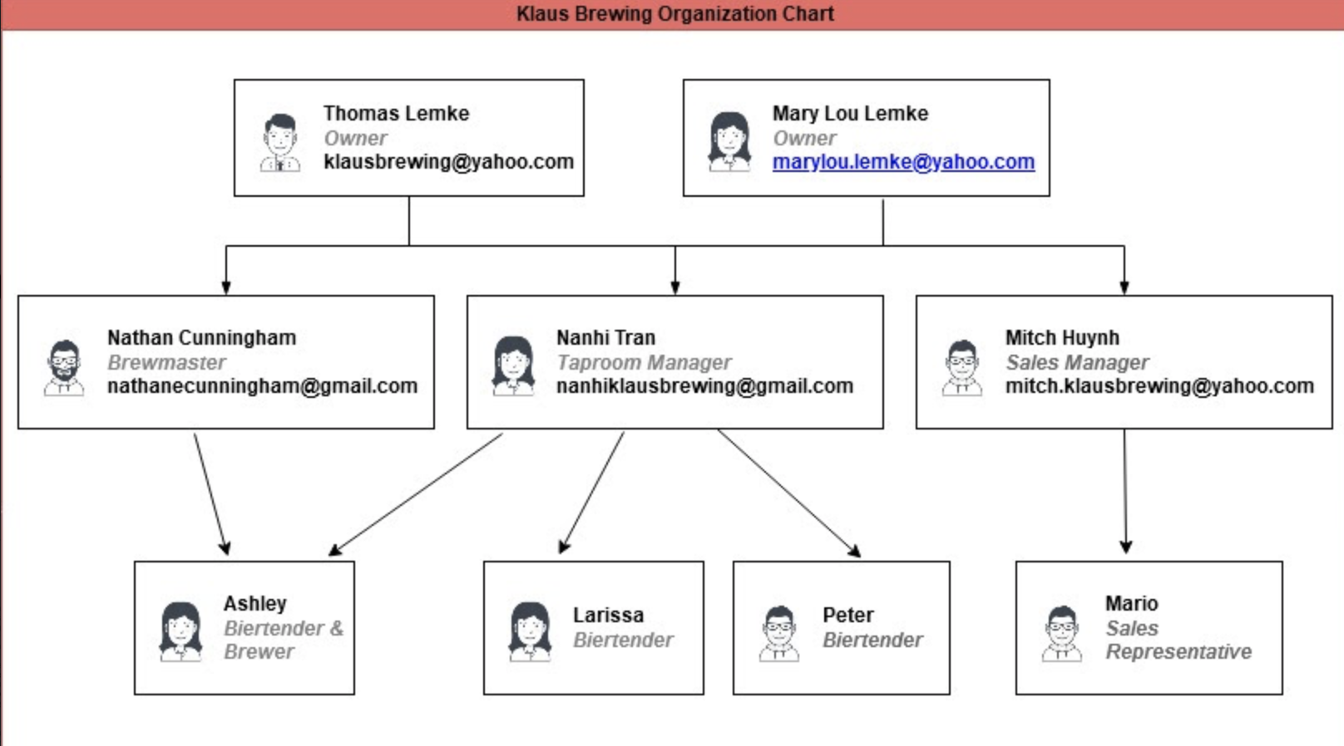
Client Organization Chart

Slide 10
Our Analysis

Slide 11
Initial Problem Statement
Our client Klaus Brewing Company, has a few needs that they want to be implemented into their business. First, their current filing system is outdated and primitive for their brewers and managers to use and receive information. Second, the swiftness in which files and supplies notices are to be accounted for and delivered to employees is extremely slow. If That process is slow, the ability to have orders shipped and made will be started and loss of customers will be iminate. Lastly, their current client holding program needs to be further completed and fortified, the ability to allow customers to feel as though they are the priority, and to reward for loyalty overtime would be ideal for our client.

Slide 12
Problems & Requirements list
Ref Number | Problem Description | Source | Date | Priority (M, K, D) | Rank | Requirements Description | Current Perfor-mance (Excellent, Fair, Poor) | Required Perfor-mance | Scope ("in" or "out")
2 | Upload spreadsheet form of merchandise and beir | Nahni | 02/16/2020 | M | 5 | Solution allows for uploading of current spreadsheets | P | E | In
5 | Loyalty Program table population | Nandhi | 11/6/2019 | M | 7 | Solution allows for table to be created depicting customer lastingness in brewery and what was purchased | F | E | In
1 | Electronic access to resources | Nahni & Group | 02/10/20 | K | 1 | Create solution that allows company to access any forms, reports, customer info and inventory online | P | E | In
4 | Forms to handle customer profiles | Group & Nandhi | 02/16/2020 | K | 3 | Solution allows customer to input data and create profile from information | F | E | In
6 | Pull up Customer Loyalty Report | Nandhi | 11/6/2019 | K | 4 | Solution allows ET to pull up any and all completed reports and tables of customer info related to purchased items | F | E | In
3 | Live update of merchandise inventory | Nandhi | 02/16/2020 | D | 8 | Solution allows client to see up-to-date readings of inventory and orders from vendors | P | F | In

Slide 13
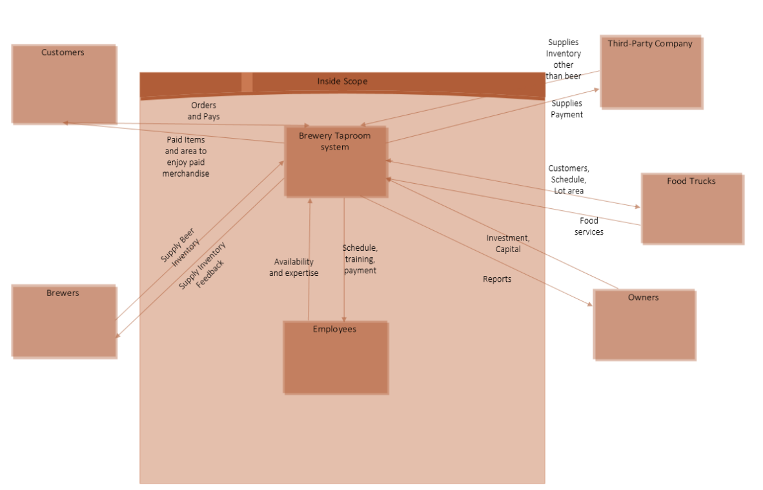
Scope Diagram

Slide 14
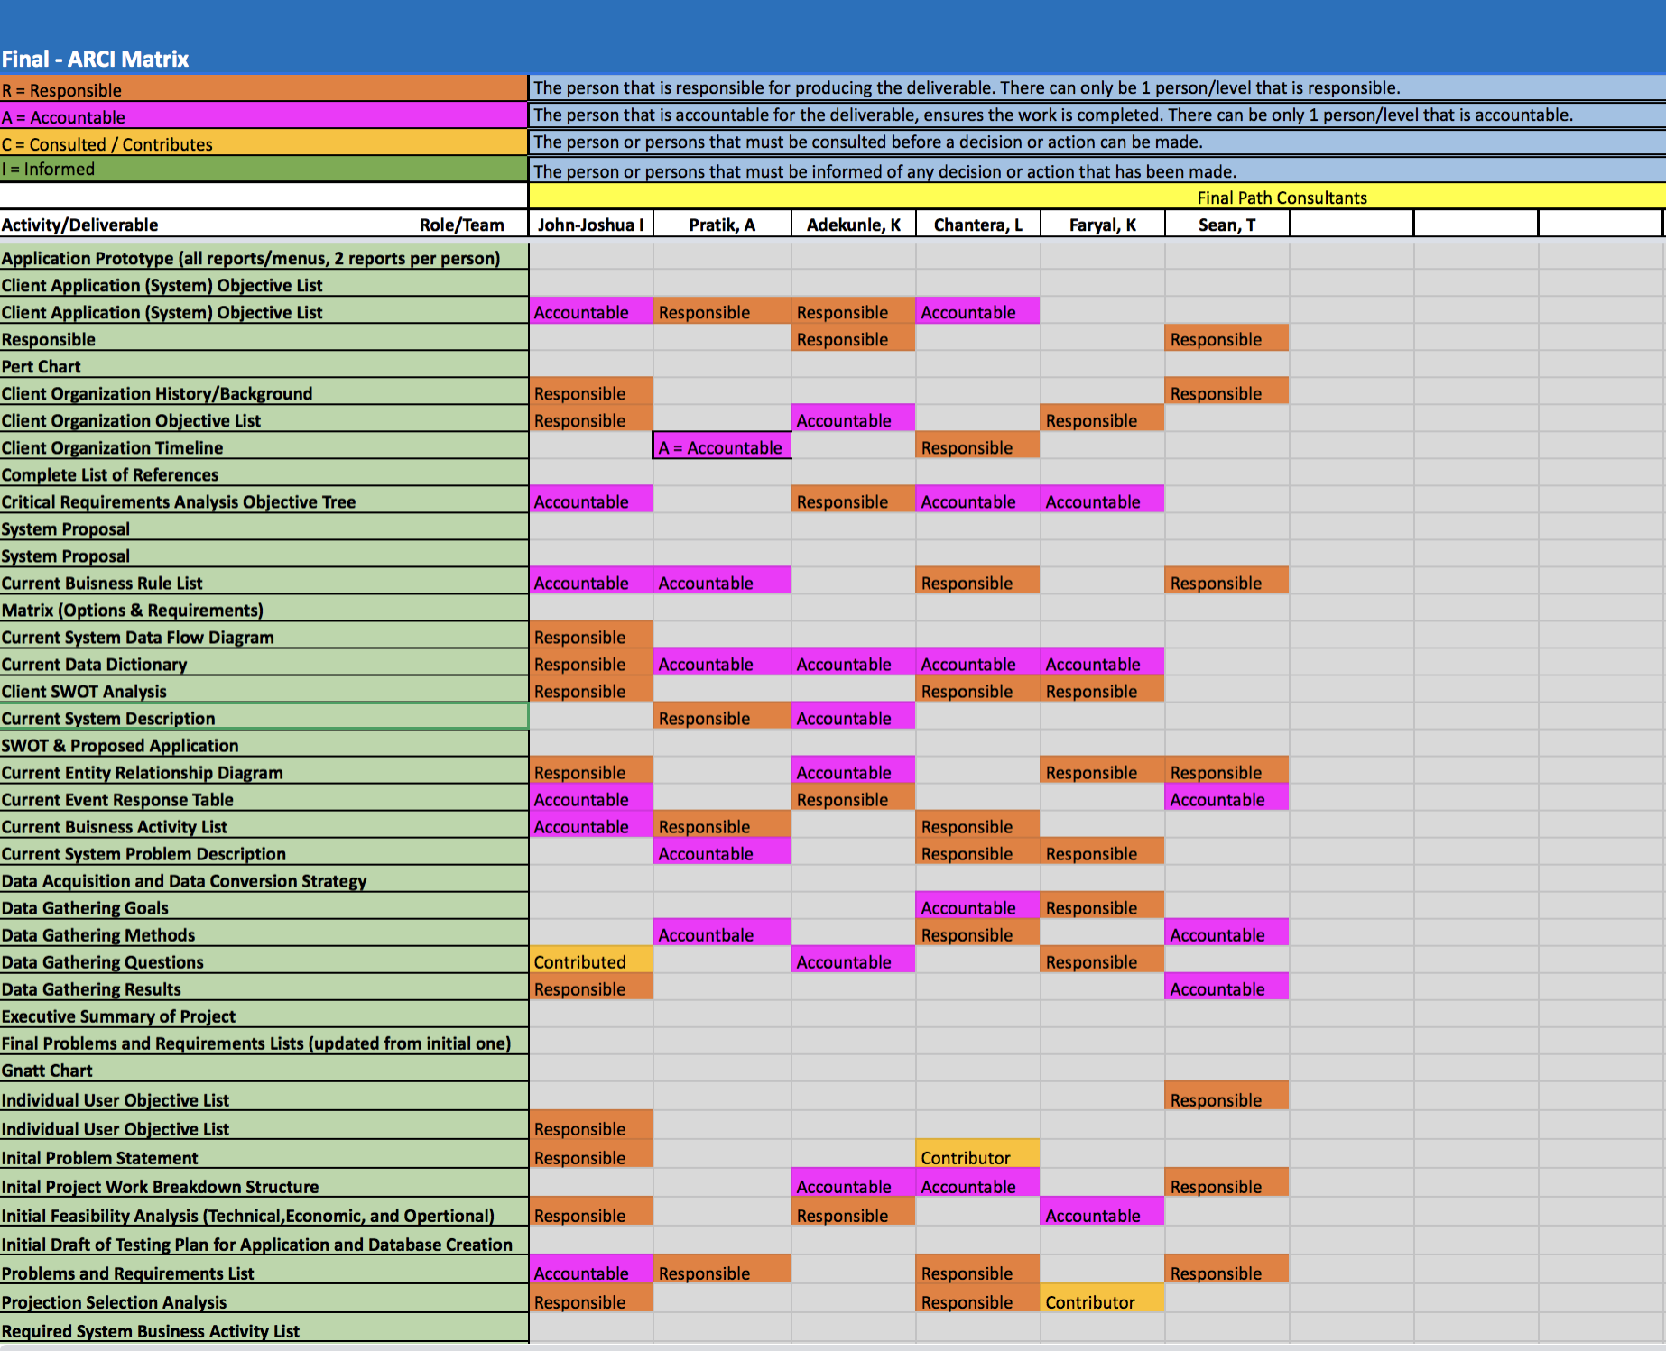

Slide 15
Data gathering goals
Our goal is to understand overall scope and method of the way Klaus brewery functions.
We also need to find out what services they offer and what methods are they using to improve those services.
It’s also important to understand what form of marketing they are utilizing. For example, are they promoting their brand through social media, ads or emails?

Slide 16
Data gathering questions
Can you describe your business in a few words?
What services does Klaus brewing company offer?
Which department is responsible for monitoring inventory and what techniques do they use?
What systems in your business need improvement?
Would y’all want to create invoices and reports for the systems?
How would you all like to interact with the new system?
Do y’all currently have a database that we can host here and connect to it?
What additional features do you want to add to your website? For example, are you interested in increasing your usual number of visitors or want to add some tool that clients can make their order online?

Slide 17
Data gathering results
Klaus Brewing Company crafts German style bier and offers a taproom and biergarten for those that want to enjoy it onsite.
Which department is responsible for monitoring inventory and what techniques do they use?
The taproom department is responsible for monitoring inventory. Inventory is done manually via paper and pencil.
What systems in your business need improvement?
Marketing – Mass emails for promotions, events etc.
Website – More interactive, more appealing, easier to use .
Inventory – What’s in stock, numbers sold, what’s available
Would y’all want to create invoices and reports for the systems?
No need for invoices. Square already produces satisfactory reports.
How would you all like to interact with the new system?
Via computer. It must be easy to access and easy to use for the non-technologically inclined.
Ideally add an email into a database and have the ability to mass email that list.
Do y’all currently have a database that we can host here and connect to it?
Yes. Square database

Slide 18
Current System Problem Description
One of the major issues that Klaus Brewery is facing is their disorganized and outdated order procurement and shipping system. Their order management is done through use of paper instead of electronically and is done manually. Since paper documents can be easily lost or can be compromised due to human error, it can put their business at risk of losing valuable supply and putting up accidental orders.Another problem that client is facing is their lack of a loyalty rewards program.
Currently, Klaus brewery does not have any sort of loyalty rewards program which can be used in order to reward returning customers by giving them some sort of discount or other benefit.
Client’s next problem is with their current web site system. Client has an outdated web page which is not engaging and its not aesthetically pleasing. Their current website is also not connected to their inventory or database system.

Slide 19
Current Organization Objective List
To design and offer a graphical user interface application with an SQL database system for Klaus Brewing Co.
To develop a better interactive website that is more aesthetically pleasing to staff and new users.
To allow more customer interaction with incentives discovered through the system.
To reduce time spent on task by refining the data capturing, storing, and retrieving methods through the implementation of an SQL database system so business information can be handled easily, effectively, and safely.
To improve the organizations current filing and storage system to handle: procurement, order_shipping, order_delivery, and other tasks of that nature.

Slide 20
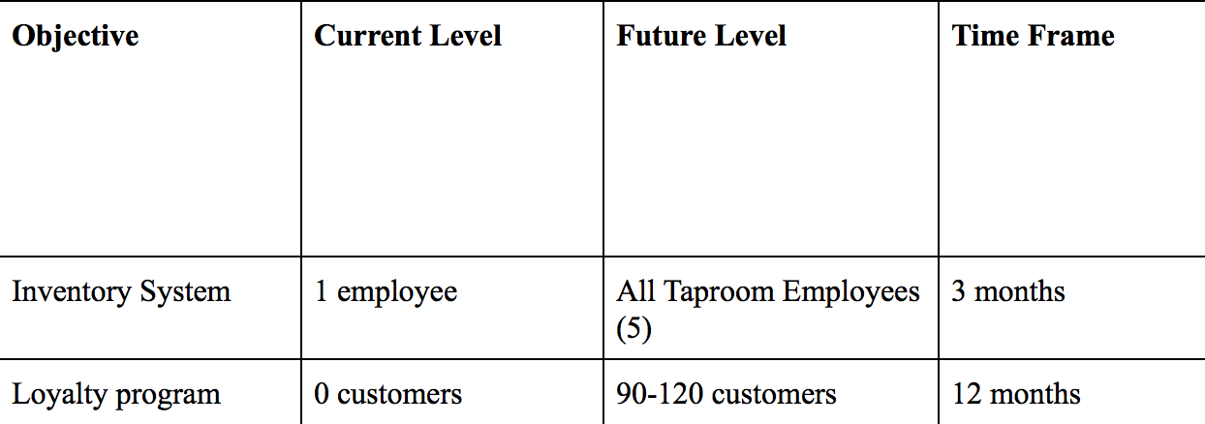
Client application(System) Objective list
To create a computerized inventory system in a way that ensures a 20% increase in data storage efficiency so that employees can access information on products faster.
To create a loyalty rewards program in a way that helps reward customers that return so that we get a 20% increase in customers that keep buying products from Klaus Brewery.

Slide 21
Individual users objective list
Brewmaster
Data entry to be computerized and stored, and for data entry to be simplified. Uniformed data format for each department to use.
Taproom Manager
Computer access to the system and fluidity of the app.
Ability to see up-to-date readings of inventory on hand.
Ability to place orders at notified time
Encourage more customers to return
Bring in more of the younger adult crowd
Sales Manager
Ability to get notifications of recurring customers.
Ability to connect to a larger customer base (use forms)
Bartender & Brewers
Ability to see up-to-date readings of inventory on hand.
Ability to place orders at notified time

Slide 22
STROBE Analysis
Klaus Brewing company hosts a friendly laid back environment where
group of people come to enjoy beer, play games, and conversate. The employees have to be friendly and conversational individuals as well as be well-versed in their German and Bier history. They offer many areas including the Brewery, the Garden area, and the main taproom area. Workers have to attend to their daily activities as well as manage the counter. Most information is written on boards and events are posted around the establishment. They have a steady flow of customers so in often observed cases, the taproom employees are multitasking or taken advantage of their free time.

Slide 23
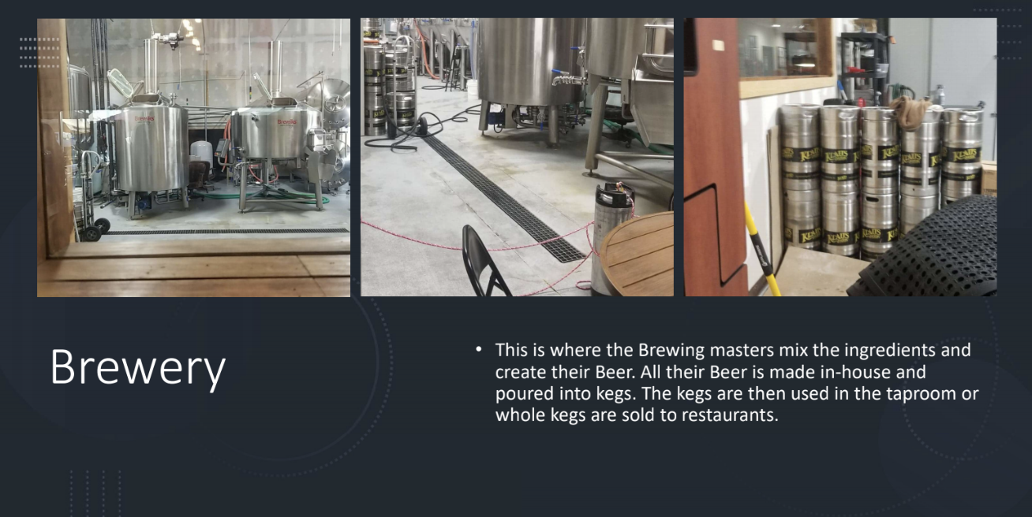

Slide 24
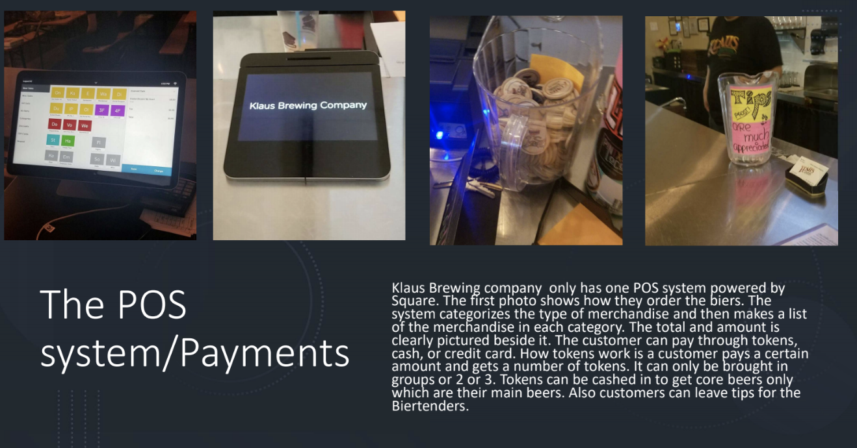

Slide 25
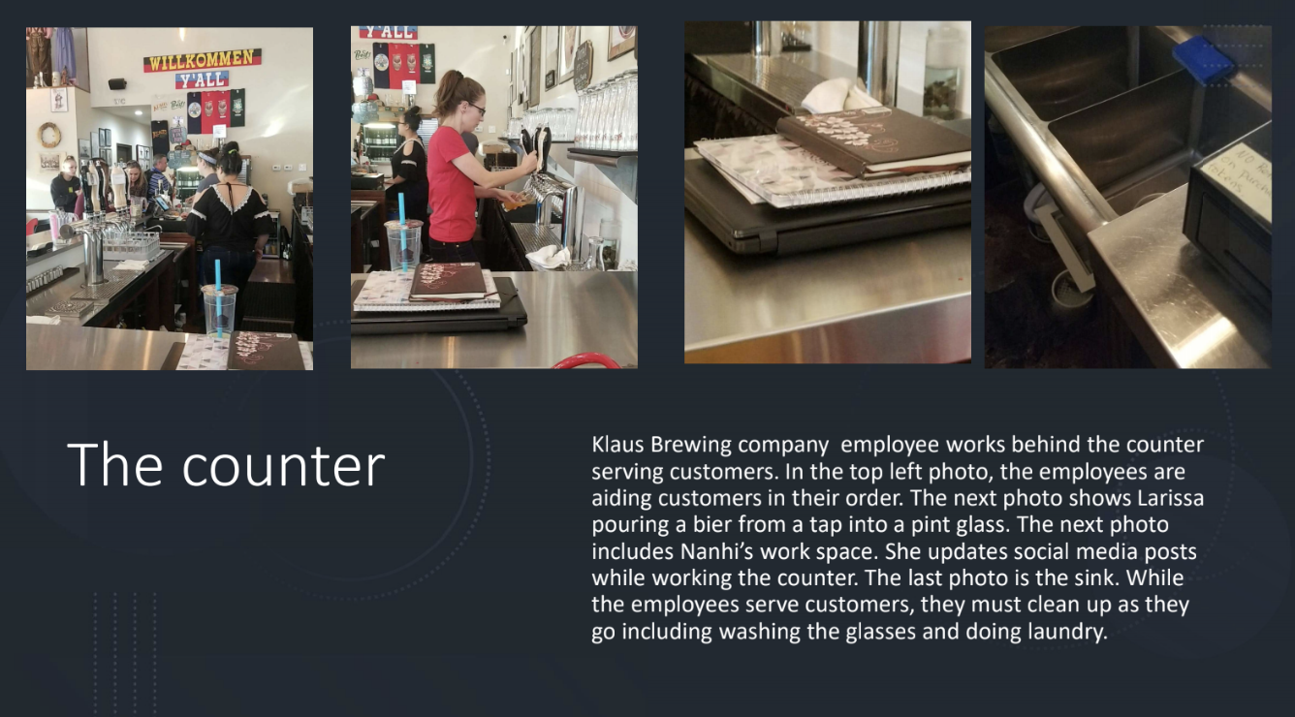

Slide 26
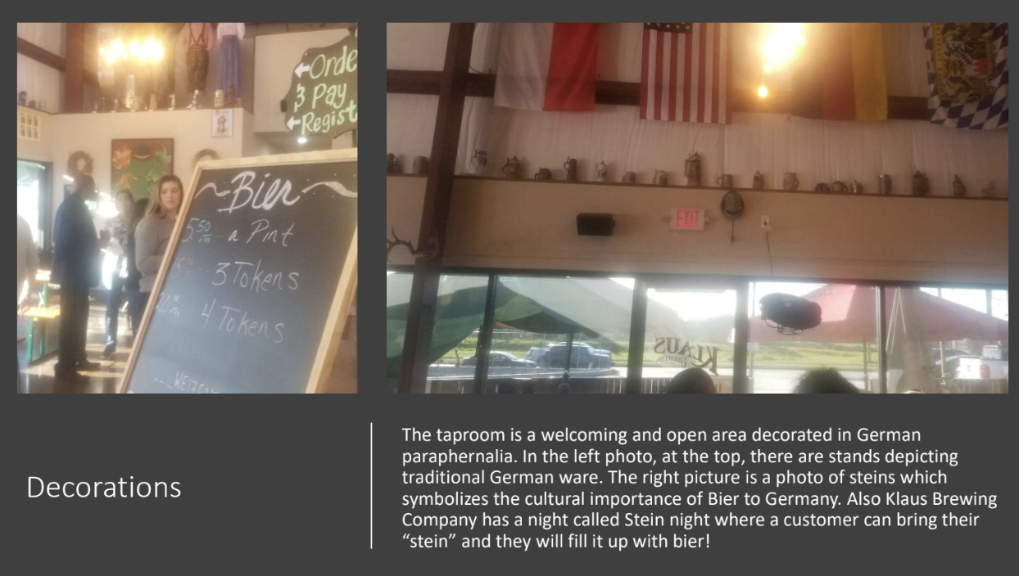

Slide 27
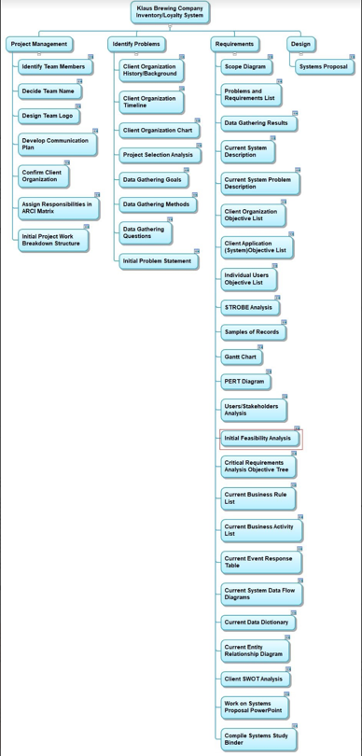
Initial Work Breakdown Structure

Slide 28
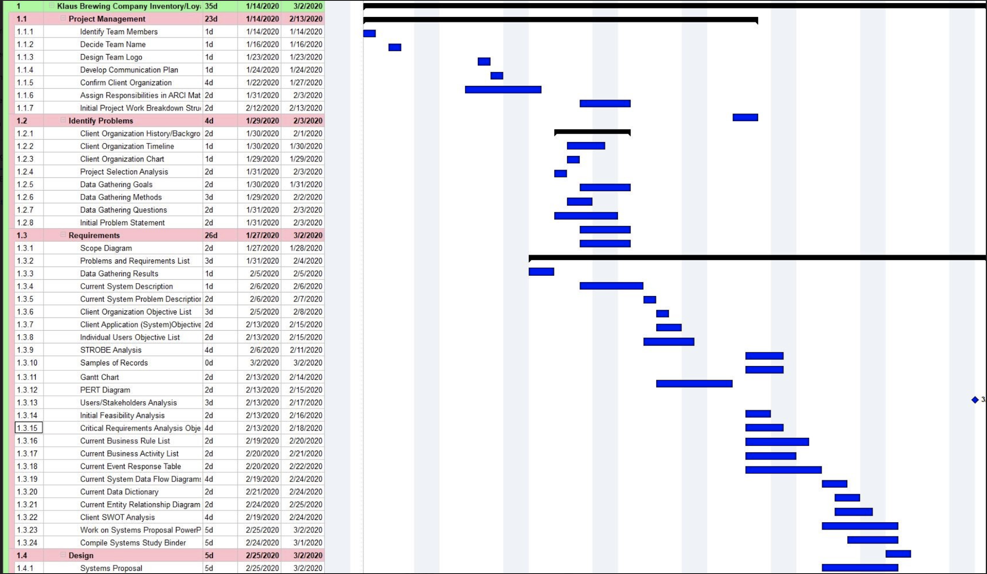
GANTT CHART

Slide 29
Users/Stakeholders Analysis
Two separate interviews were conducted to obtain the results of the analysis. The interviewees included the Taproom Manager and Bartenders (bartenders for clarity) because these employers would be utilizing the system and be mostly affected by the system’s performance.
The interviews allowed us to really narrow down the scope of the project. Some of the system’s objectives such as adding the kegs for the sales team is currently out of scope. Yet focusing on the inventory first would allow us to build a system that can be built upon
Overall, our system seems to be welcomed and there seems to not be much resistance, we just have to build a simple yet efficient system to increase productivity in the workplace.

Slide 30
Initial feasibility analysis
Technical
The analysis was based on the company’s current technical situation and the future requirements for the new system. We have found that our client is going to need at least 7-9 dedicated PC’s that have the capability of connecting to a server. With that the client needs a data server being cloud based or an in-house system.
Economical
Then our client will need to acquire a database to hold the data and files of their business. That we either incorporate a cloud-based server or an in-house option. They can either rent or buy a server. By renting the server for one fixed monthly price from a service provider like ServerMania, Or purchase a server from a company like Dell and store it in their office.
Operational
Since the technical and economic feasibility of the project is attainable, the operational aspect of the project is analyzed. Since there's no major technical and economic constraints posed, the main thing to look for is the technical prowess of the workers who will utilize the system.

Slide 31
Current business rule list
If a customer buys any glass, their first fill is free.
If a customer forgets their credit card, Klaus will close their tab and automatically charge 20% gratuity on the bill.
Tables cannot be reserved unless the customer pre-purchases a package.
On Thursdays, customers can bring in their own Stein for a free fill. However, the fill is limited to only one liter.
If customers want to participate in any event (trivia, bingo, comedy night, or etc.), they must purchase at least one bier.
Tokens can be exchanged for one pint of a core bier. Tokens do not have expiration dates.

Slide 32
Current business activity list
Daily Taproom Activities
Prepare Taproom for the day by following normal opening protocols
Set up Beer Garden (including umbrellas and outside games)
Serving Beer, wine, or soda to Customers
Selling Merchandise: glasses, hats, shirts, or 22oz to-go bottles of any beer
Informing Customers of where to get Klaus Beer from other Restaurants
Weekly Taproom Activities
Inventory is taken
Deep Clean taproom and beer garden following Sunday Deep Cleaning Checklist
Manager Meetings (All managers and Owners)
Sales Meetings (Sales Manager, Sales Team Members, Owners)
Yearly Taproom Activities
Oktoberfest
Maifest
Inspections
Safety Infections
TABC compliance audit

Slide 33
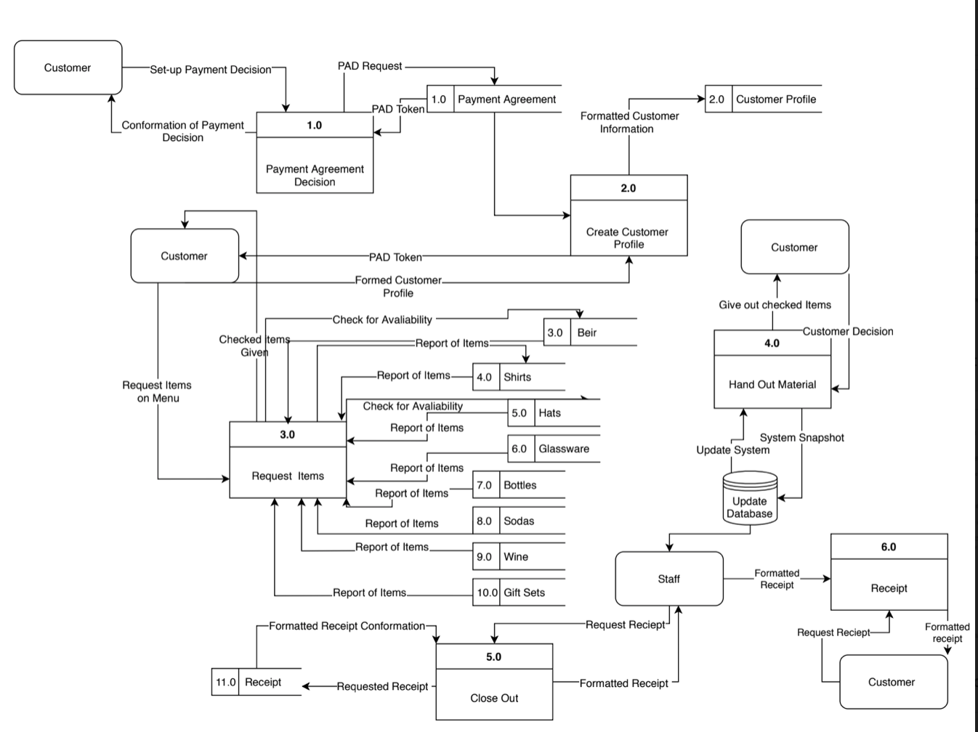
Current System Data flow Diagram

Slide 34
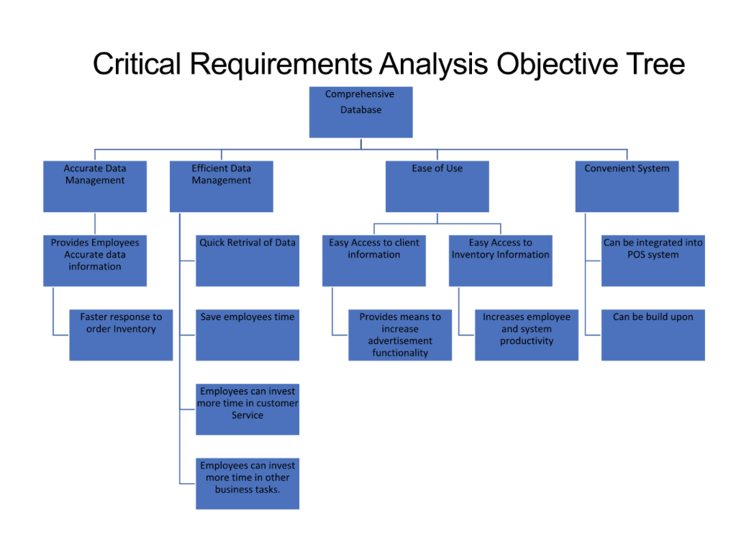

Slide 35
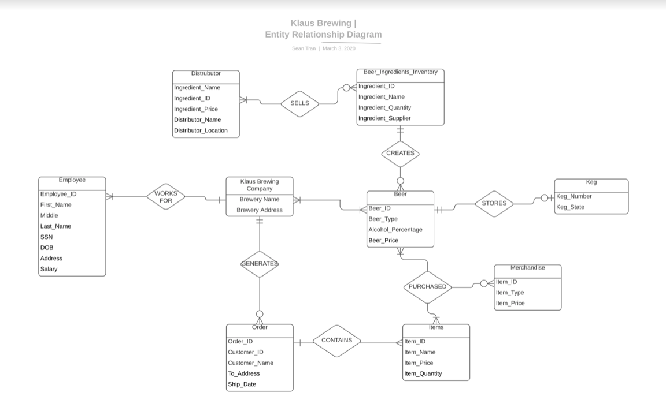
Current Entity Relationship Diagram

Slide 36
Current Event Response table
Event | Response
Prepare Taproom for the opening | Taproom managers and employees come in early to set up beer gardens, games, and set up chalk-boards with daily specials or events of the day.
Serving Customers | Biertenders choose what the customer requests via the POS system and charges the customer. Then hand the customers their paid items which could be Beer, wine, soda, or merchandise.
Customer inquires about food | Biertenders direct customers to Food Trucks available on the premises.
Event night | Biertenders and Taproom managers set up events. Then gives customers a countdown timer so they settle in and participate if they want.
Keg Changes | If kegs become defective, Kegs are switched out via the Bartenders or Taproom Manager.

Slide 37
General Meetings | The owners and managers go over expectations for the week.
Stein Night | If customers bring their own stein, it is filled up by employees.
Quarterly Reports | Reports to show what Klaus Brewery has done in the previous months
October Fest | Set up for the festival by preparing inventory, events, and food trucks. Make sure adequate advertisement is utilized.
MaiFest | Set up for the festival by preparing inventory, events, and food trucks. Make sure adequate advertisement is utilized.
Inspections | Prepare the Taproom and Brewery for safety inspections and TABC compliance audits. Conduct Mold Inspections and Equipment Inspections to make sure productivity is not slowed down due to equipment failure or temporary taproom closings.

Slide 38
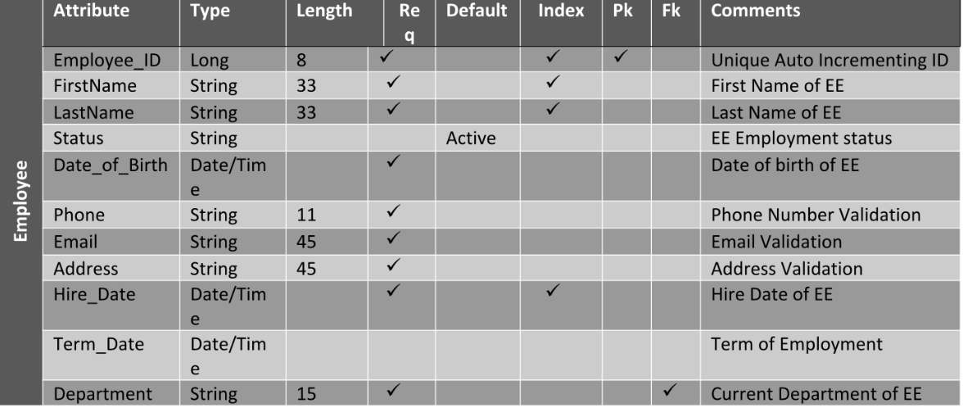
Current data dictionary

Slide 39
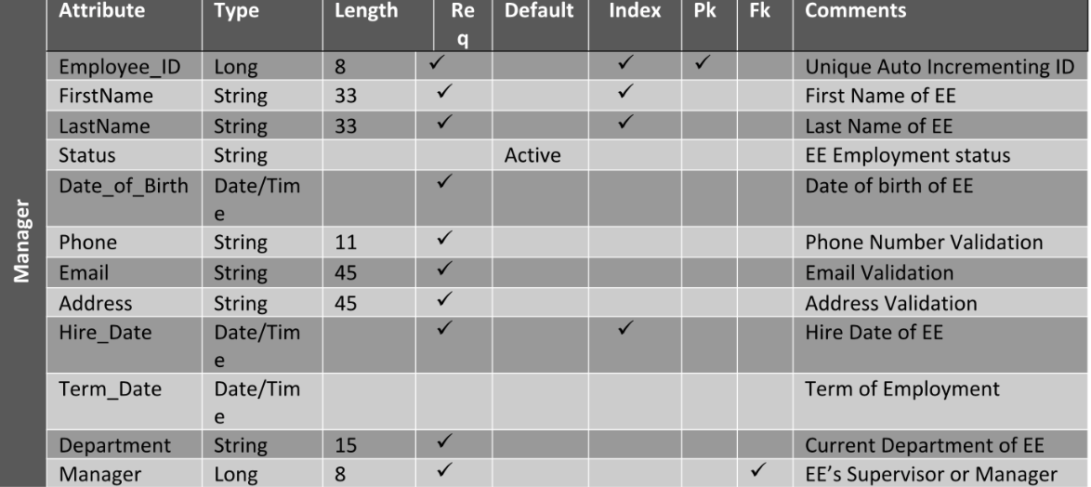

Slide 40
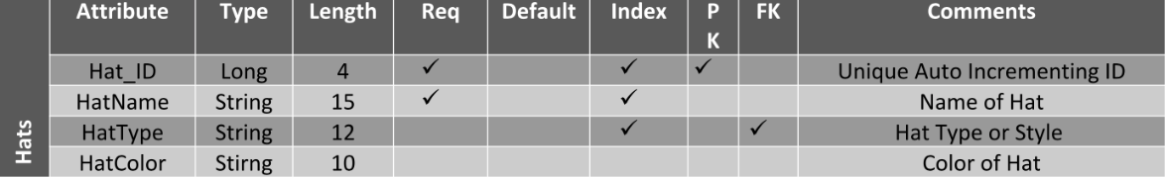
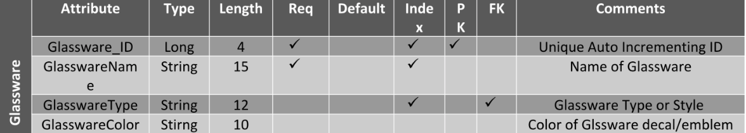

Slide 41
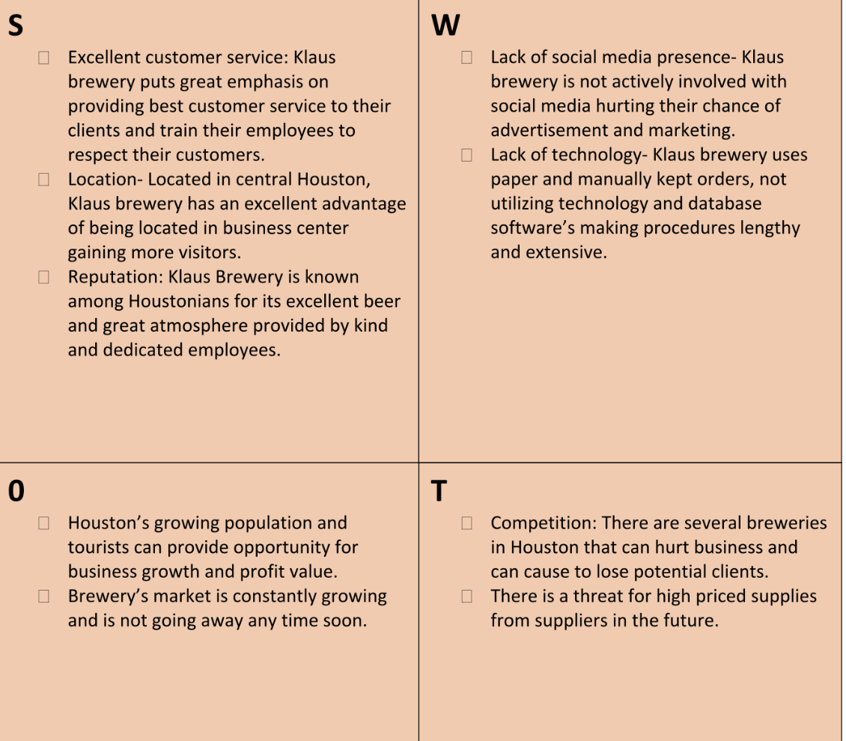
Client SWOT Analysis

Slide 42
Our System proposal

Slide 43
A system that creates an inventory system that inventories merchandise including glasses, gift sets, to go bottles, sodas, wines, hates and t-shirts .This system will assist the client with keeping up with their products and knowing when to repurchase. We are also proposing to create a system that will function as a database for customer data and relates it to how much money they spend, the merchandise they have purchased and how often they visit the Client’s site. This system will also hold information of how long the customer has been a member with Klaus Brewing Company. Data from the database system will assist in creating a loyalty program to give owners an opinion in returning members who should receive discounts and benefits regarding the program.
Overall Approach

Slide 44
Our Options
1)System will also hold information of how long the customer has been a member with Klaus Brewing Company. Data from the database system will assist in creating a loyalty program to give owners an opinion in returning members who should receive discounts and benefits regarding the program. This system will be integrated into their POS system so they can easily transition into using our system.
2)system will also hold information of how long the customer has been a member with Klaus Brewing Company. Data from the database system will assist in creating a loyalty program to give owners an opinion in returning members who should receive discounts and benefits regarding the program. This system will not be integrated into their POS system, but is a standalone system. This could be beneficial if they do decide to change from Square.

Slide 45
References
“Brewers Association Releases Annual Growth Report.” Brewers Association, 2 July 2019, www.brewersassociation.org/press-releases/brewers-association-releases-annual-growth-report/.
Egan, John. “Houston's Big Population Boom Continues with This Many New Residents Each Day.” CultureMap Houston, 24 Apr. 2019, houston.culturemap.com/news/city-life/04-23-19-houston-the-woodlands-sugar-land-population-growth-us-census/.
Takahashi, Paul. “Houston's Craft Beer Craze More than Doubles Brewery Space in Six Years.” Houston Chronicle, Houston Chronicle, 23 Aug. 2019, www.chron.com/business/texas-inc/article/Houston-s-craft-beer-craze-more-than-doubles-14370128.php.
“What's on Tap...” Home, www.klausbrewing.com/.
Interviews with Klaus Brewery management
Results from data gathering
Class Lectures
Notes
Environment of business

